Slide 1


MANTHAN 2021
Premier Hackathon for National Security
DEEPFAKE CONTENT DETECTION USING ADVANCED GAN
RATHINAM COLLEGE OF ARTS AND SCIENCE
TEAM NAME : THE_FANTASTIC_5
PSID : INTL-FCD-15
TEAM MENTOR NAME : NAREN J
TEAM LEADER NAME : JASMINE AK
TEAM MEMBERS:
AKASH R
GAYATHRI M
MAHALAKSHMI G
SARAVANAVEL V

Slide 2

PROBLEM STATEMENT : INTL-FCD-15
IDENTIFICATION OF ARTIFICIALLY GENERATED DEEP FAKE CONTENT
Deepfake is a technique that uses deep learning algorithm to create fake images usually by swapping a person’s face from a source image into another person’s face in a target image, the algorithm can create fake images that humans cannot distinguish them from authentic ones.

Slide 3
MOTIVATION
Deep fake technology has opened doors to many new possibilities of picture generation but also raised many issues of moral and legal matters
The Motive is to get aware of fake images through Deep Learning technology.

Slide 4
IDEA INTRODUCTION
IDENTIFICATION OF ARTIFICIALLY GENERATED DEEP FAKE IMAGE CONTENTS
Deep fake technology has opened doors to many new possibilities of picture generation but also raised many issues of moral and legal matters
The Motive is to get aware of fake images through Deep Learning technology
To build a Deep Learning Model which classifies real and fake images.

Slide 5
SOLUTION STACK
DEEP FAKE CONTENT DETECTION
- BASELINE
DEEP LEARNING (DL) :
Deepfakes uses deep learning technology to manipulate images, videos, audios of a person that humans cannot differentiate them from the real one.
In deepfake AI, deep learning algorithms that teach themselves how to solve problems with large data sets, are used to swap faces in videos, images, and other digital content to make the fake appear real.

Slide 6
SOLUTION STACK (Continuation)
GENERATIVE ADVERSARIAL NETWORKS(GAN) :
GAN is an algorithmic architectures that use two neural networks, pitting one against the other (thus the “adversarial”) in order to generate new synthetic instances of data.
CONVOLUTIONAL NEURAL NETWORKS(CNN) :
Convolutional Neural Network(CNN) is a Deep Learning algorithm which can take in an input image, assign importance to various aspects in the image and be able to differentiate one from the other.

Slide 7
DEEPFAKE IMAGE CONTENTS
OBJECTIVES :
IMAGE DETECTION :
Idea Introduction
Outcome And Approach
Architecture
Vision
VIDEO DETECTION :
Idea Introduction
Outcome And Approach
Architecture
Vision

Slide 8
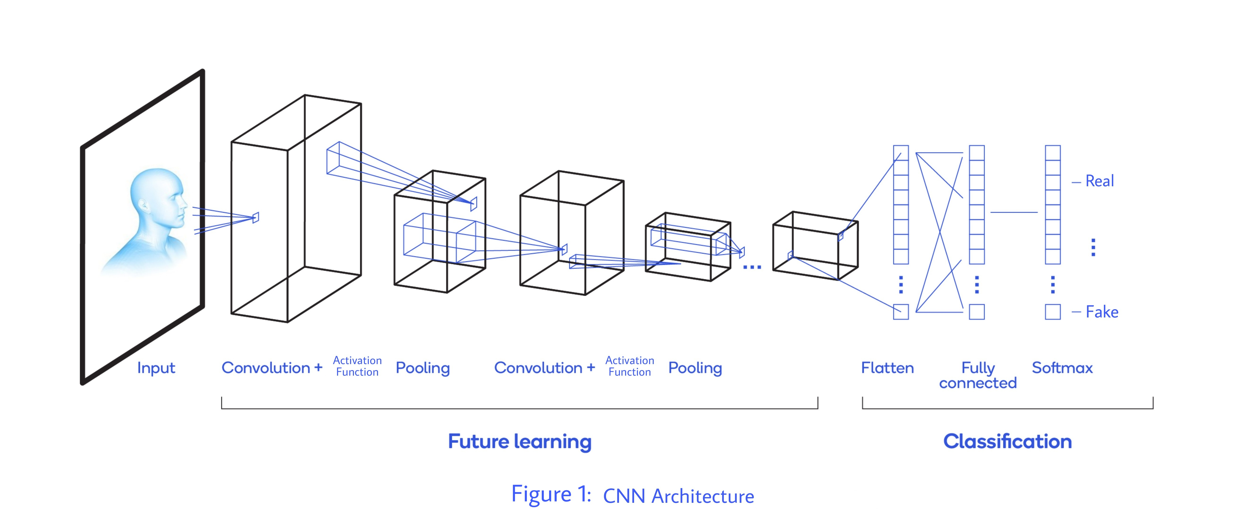
CNN ARCHITECTURE (DISCRIMINATOR)
Source : Own Image

Slide 9
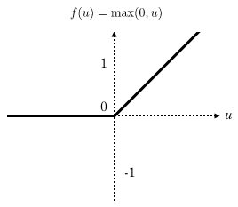
ACTIVATION FUNCTION USED FOR CONVOLUTION LAYERS
RELU Activation Function

Slide 10
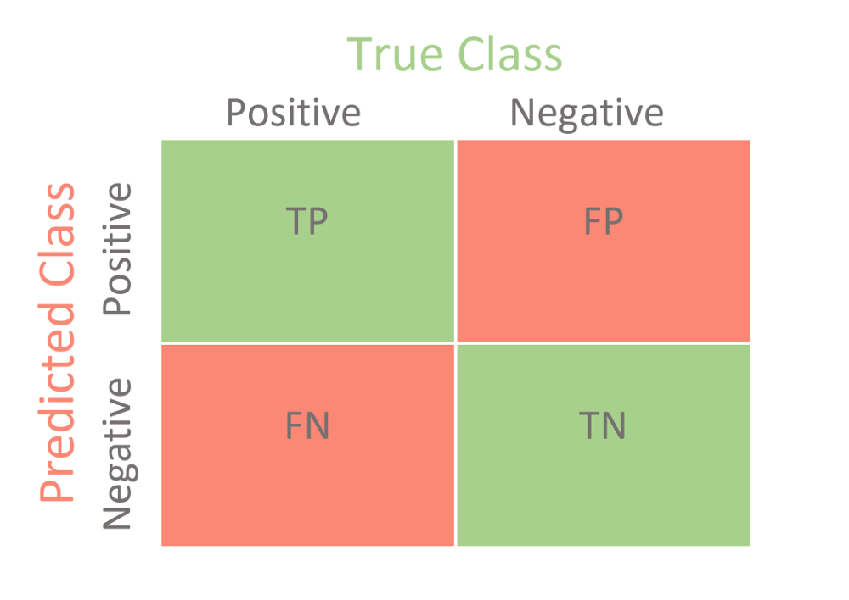
EVALUATION MATRIX
PRECISION = TP / (TP + FP)
RECALL = TP / (TP + FN)

Slide 11
DATASET
140 K Real and Fake Faces →From Kaggle
70 K Real from Flickr
70 K Fake from GAN generated
Train Set
50 K Images
Validation Set
10 K Images
Test Set
10 K Images

Slide 12
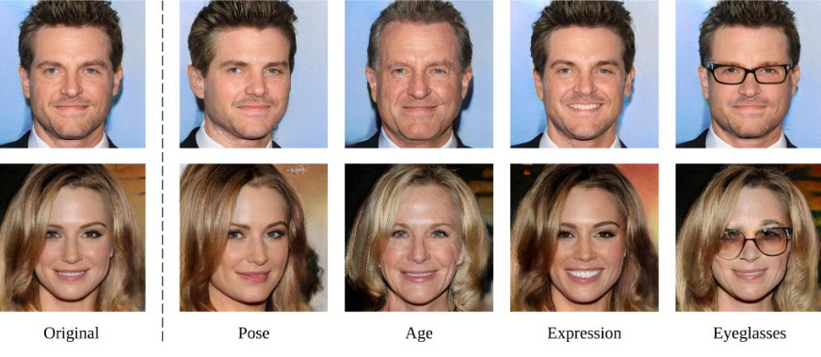
SAMPLE DATASET

Slide 13
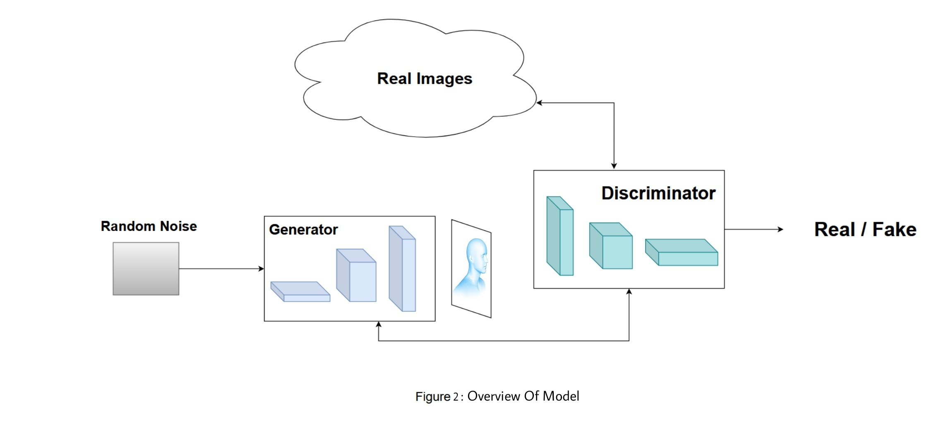
VISION
Source : Own Image

Slide 14
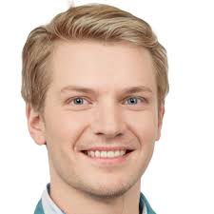
APPROACH
POSITION OF EYE
POSITION OF NOSE
POSITION OF LIPS

Slide 15
ACHIEVED ACCURACY
MODEL ON REAL AND ARTIFICIALLY GENERATED DEEPFAKE IMAGE DETECTION
86%→ 91%→ 96%

Slide 16
VIDEO DETECTION
IDEA INTRODUCTION
Deepfakes are synthetic media in which a person in an existing video is replaced with someone else's likeness
It can create videos of public figures doing or saying things they never did
The creator behind those videos has turned it into a profession by launching a company called Metaphysic to make hyper realistic videos with AI.

Slide 17
OUTCOME
Our outcome is to categorize between real and fake or artificially generated videos which more likely as real ones using Generative Adversarial Network.
Deepfake digital videos have serious negative impacts on news integrity, legal forensics and social security.
In order to detect deep fake digital videos more accurately, a hybrid Generative Adversarial Networks (GAN) is proposed.

Slide 18

APPROACH
Videos are converted into frames
Each frame is considered as image

Slide 19
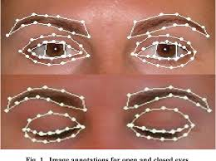
Eye Movement and Blink-ness comparison in real and fake videos

Slide 20
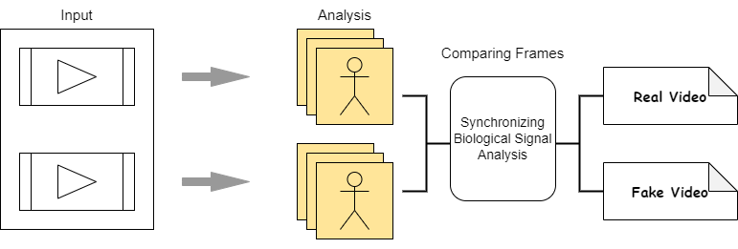
ARCHITECTURE (GENERATOR)
Source : Own Image

Slide 21
DEVELOPMENT PIPELINE
Output Of Discriminator (Real/Fake)
Loading Datasets
Generation of fake contents Using
Generative Adversarial Network(GAN)
Step 2
Step 4
Step 1
Step 3
Step 5
Pre-processing:
1.Data
Augmentation
2.Data
Visualization
Modelling a Discriminator Using Convolutional Neural Network(CNN)

Slide 22
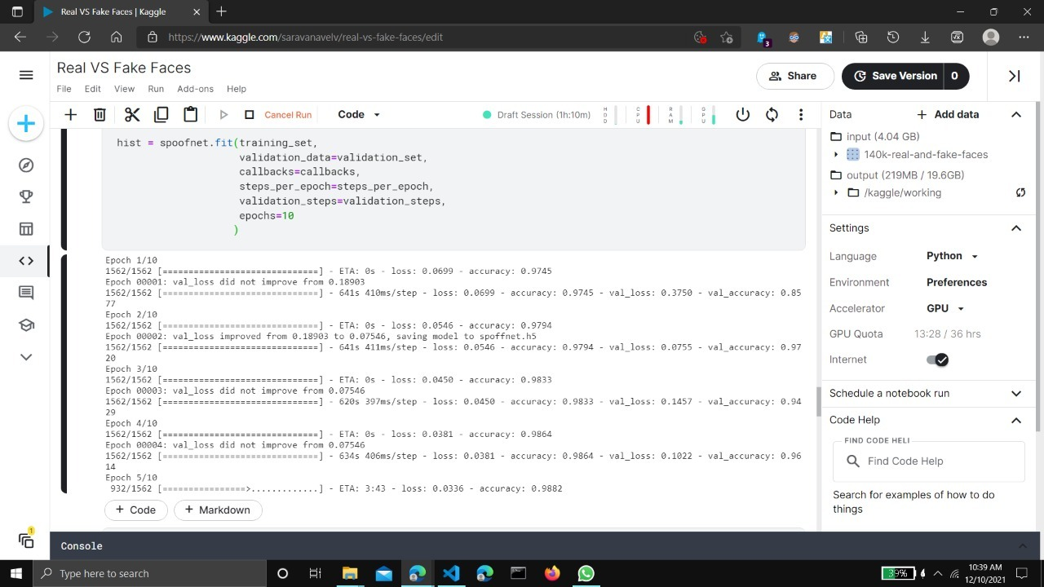
TRAINING AND RESULTS

Slide 23
DEPLOYMENT OF OUR MODEL
django
Model
(as web app)
+

Slide 24
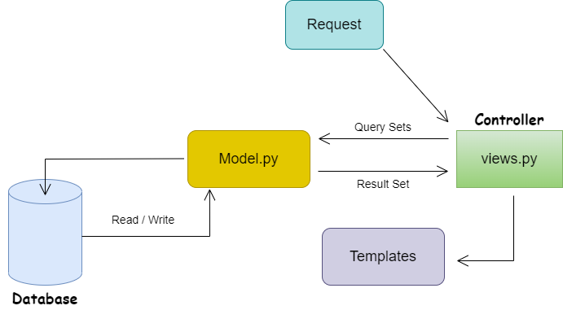
WORKING OF DJANGO
Source : Own Image

Slide 25
Django currently supports two interfaces:
WSGI - Web Server Gateway Interface
ASGI - Asynchronous Server Gateway Interface
Communication between the web server and the web applications in most of the python web frameworks

Slide 26

SECURITY FEATURES IN DJANGO
Cross site scripting (XXS) protection
Cross site request forgery (CSRF) protection
SQL injection projection
Clickjacking protection
SSL / HTTPS

Slide 27
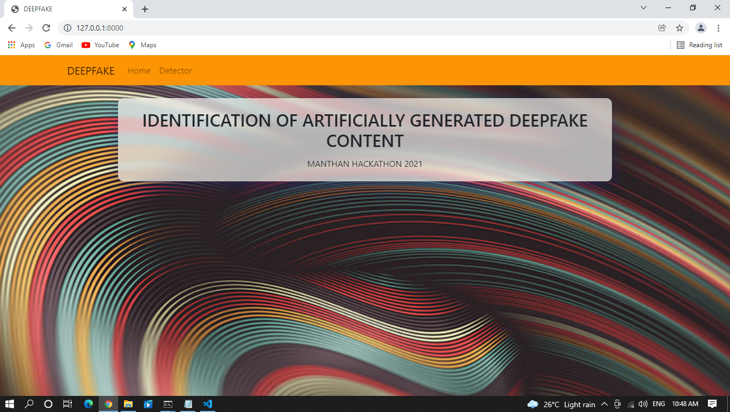

Slide 28


Slide 29


Slide 30


Slide 31
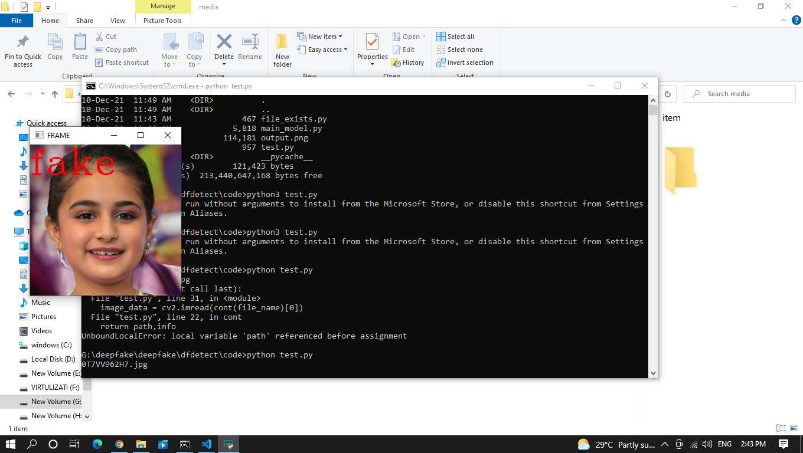

Slide 32
THANK YOU

